Slide 1
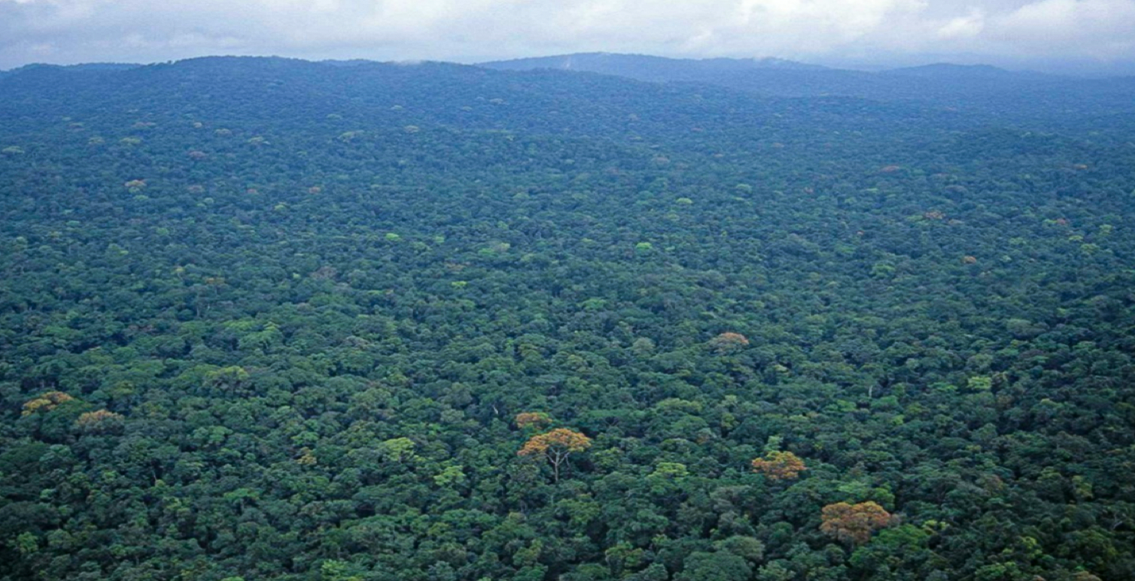


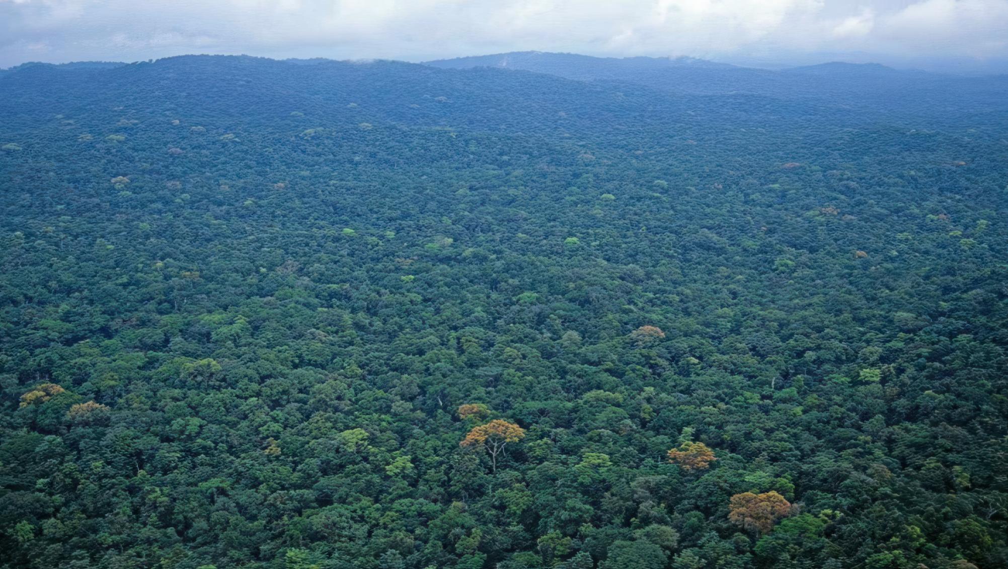
FORESTRY DEVELOPMENT AUTHORITY (FDA)
An Overview of the National Forest Forum 2025
Held at Ellen Johnson Sirleaf Ministerial Complex
Presented by: Nora Bowier, Deputy Managing Director, Forestry Development Authority

Slide 2
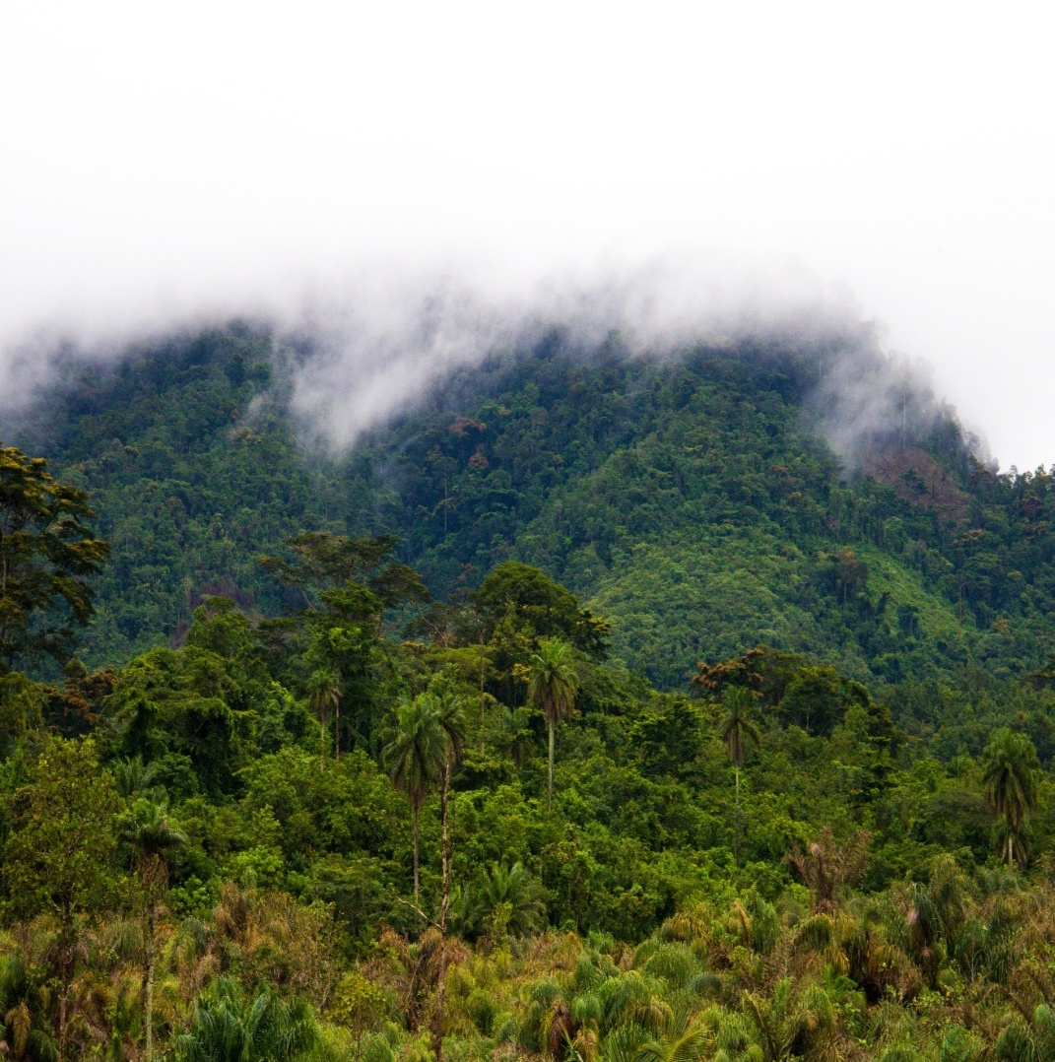
Importance of Liberia’s forest
Forest account for 43% of the remaining Upper Guinean Forest, a globally significant biodiversity hotspot.
Home to unique ecosystems and endemic species.
Provide livelihoods for over 1.5 million people
Contributed 10% of GDP (2014-2016) and 10,400 direct jobs (2015)
Critical for climate regulation, biodiversity conservation and rural development.

Slide 3
Forest Governance Progress
Major policy reforms since 2003:
2006: National Forest Reform Law (NFRL)
2009: Community Right Law (CRL)
2018: Land Rights Act (LRA)
Legal Foundation for the “Four Cs” Framework which guides forest management :
Community Forestry
Conservation
Carbon Sequestration
Commercial Forestry

Slide 4
Key Challenges
Deforestation & degradation (approximately 0.46% annually, 2005 – 2015)
Illegal logging & unregulated artisanal mining
Agriculture expansion & shifting cultivation
Weak inter-sectoral coordination
Emerging climate change impacts
Pressure on protected areas and forest reserves

Slide 5
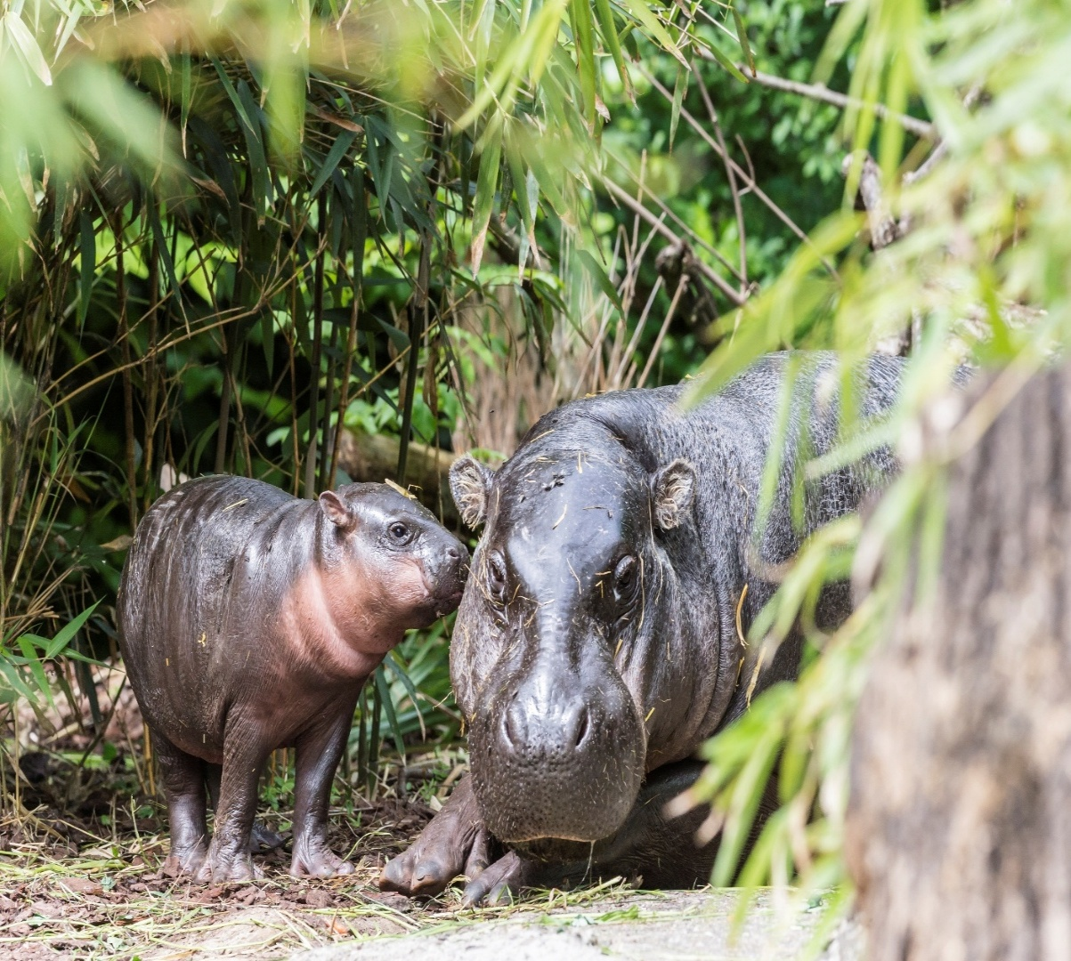
National Forest Forum 2025
Theme: Enhancing Partnership for Sustainable Forest Management and Climate Resilience.
Building on 2023 National Forest which highlighted:
Key initiative like Liberia Forest Sector Project (LFSP) - World Bank
WABILED Program – USAID
Wonegizi REDD+ Pilot Project
Evaluated Key policies
Set out action points on governance, partnerships and carbon market readiness.

Slide 6
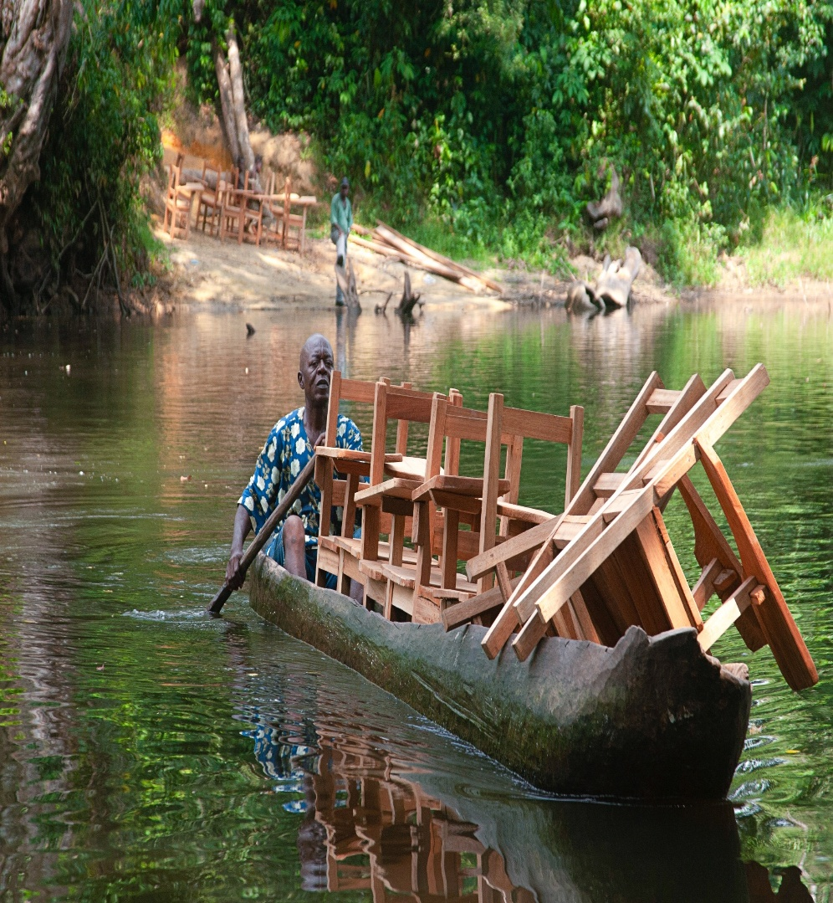
NFF Objectives continue
Review progress and lessons since 2023
Address sectoral challenges amid emerging global and national transitions:
Proposed VPA cancellation
Transition to Forest Partnership
Implementation of EU Deforestation Regulation (EUDR)
Engagement with the Broader Market Recognition Coalition
Strengthen cross section coordination under the AAID framework.
Support Liberia’s commitments to:
UNFCCC (Climate Change)
UNCCD (Combat Desertification)
UNCBD (Biodiversity Conservation)

Slide 7
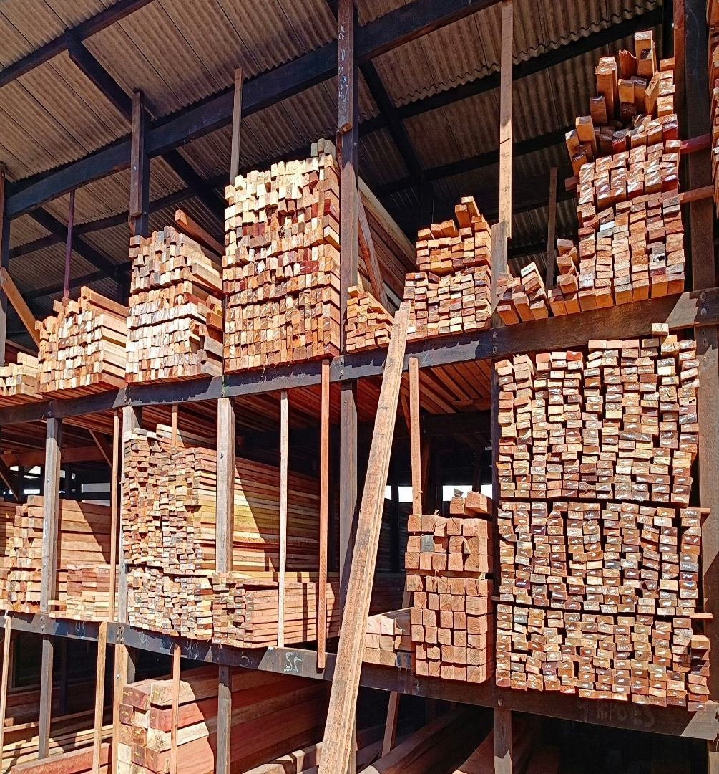
Expected outcome
Renewed political and stakeholder commitment to sustainable forest management.
Strengthened governance and inter sectoral coordination.
Clear policy direction for climate resilience and low emission development.
Enhanced international partnership and financing opportunities.
Contribution to achieving AAID environmental sustainability pillar and global conventions.

Slide 8
Structure of the program
Day 1 : Plenary Sessions including formal opening
Day 2: Thematic Workshops: Community Conservation and Carbon
Day 3: Plenary Sessions including presenting the outcome of thematic Workshop, Highlevel Panels Discussions and Adoption of a Declaration

Slide 9
Strategic Message
Participants: government, development partners, civil society and communities

Slide 10
Key messages
Liberia’s forest are not just a natural asset; they are foundation for inclusive growth, climate resilience and sustainable national development

